Slide 1

BCA Ist Semester Introduction of Logic Circuit and Digital Design(ILCDD) Course Code: BCAC003
Presented by:
Mr.Anuj Kumar
Assistant Professor, Dept. Of CE&A
GLA University, Mathura

Slide 2
J K Flip-Flop
JK flip – flop is named after Jack Kilby, the electrical engineer who invented IC.
JK flip – flop is called a Universal Programmable flip – flop because, using its inputs J (Preset), K (Clear), function of any other flip – flop can be imitated.
It is the modification of SR flip – flop with no Invalid state.

Slide 3
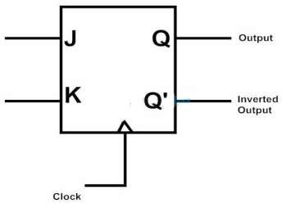
JK Flip-Flop
In this the J input is similar to the SET input of SR flip – flop and the K input is similar to the RESET input
And outputs are
one is main output represented by Q and
the other is complement of Q represented by Q’.
The symbol of JK flip – flop is shown below.

Slide 4
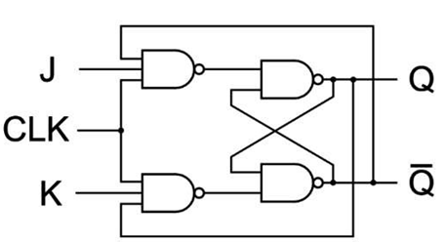
Construction & Logic Circuit
JK Flip-Flop Using NAND gates

Slide 5
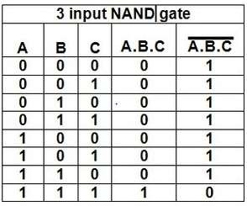
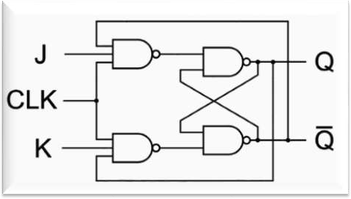
NAND Truth table
A | B | Y
0 | 0 | 1
0 | 1 | 1
1 | 0 | 1
1 | 1 | 0

Slide 6
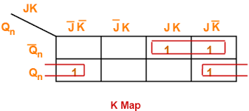
JK Flip-Flop Characteristic Table
Q(t) | J | K | Q(t+1)
0 | 0 | 0 | 0
0 | 0 | 1 | 0
0 | 1 | 0 | 1
0 | 1 | 1 | 1
1 | 0 | 0 | 1
1 | 0 | 1 | 0
1 | 1 | 0 | 1
1 | 1 | 1 | 0
Characteristics Equation= Q’J+QK’

Slide 7
T Flip-Flop
Toggle Flip-flop is another type of bistable sequential logic circuit based around the previous clocked JK flip-flop circuit.
Toggle flip-flops have a single input and one or two complementary outputs of Q and Q

Slide 8
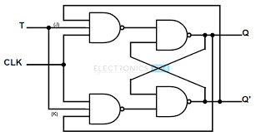
Construction & Logic Circuit

Slide 9
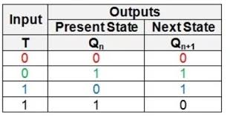
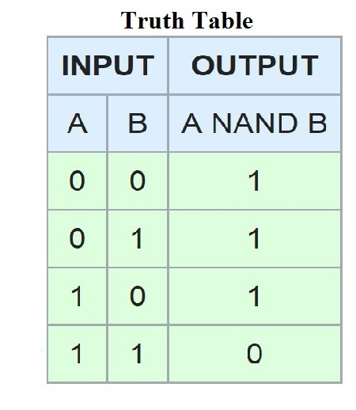
Characteristic table
NAND GATE Truth Table
Characteristics Equation= Q’T+QT’

